Slide 1
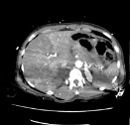
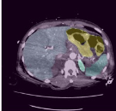
Segmentation Part
Classification Part
Cropped Image
3D Model
Bowel
Bowel
Extravasation
Extravasation
Liver
Liver
Stacking Model
3D segmentation
Crop Image
Kidney (left)
Kidney (left)
Kidney (right)
Kidney (right)
Spleen
Spleen

